Slide 1
Battle River Soccer Association
E2E Training
2023

Slide 2
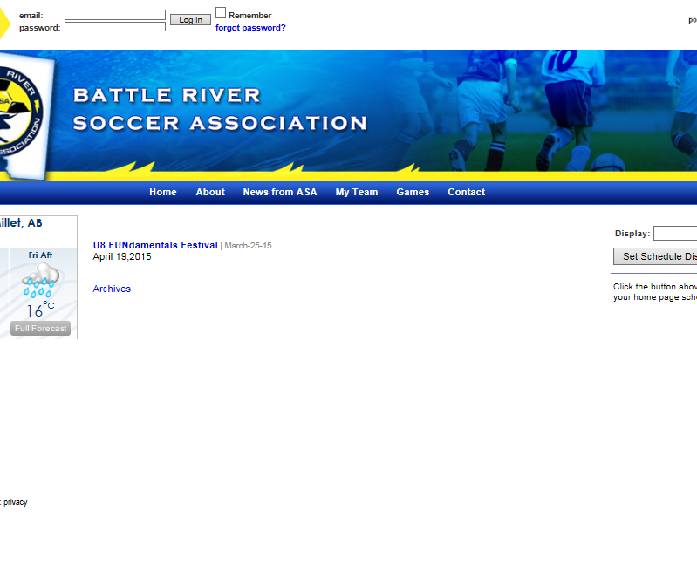
www.battleriversoccer.com
We need all teams to play their part in keeping the site up to date.
Our website is
www.battleriversoccer.com

Slide 3
Pre Season Task
Each coach or manager has to perform the following tasks before the season starts:
  Activate their My Team account
  Enter their player roster
  All Team Officials listed on your team roster should also be activated on the My Team account

Slide 4
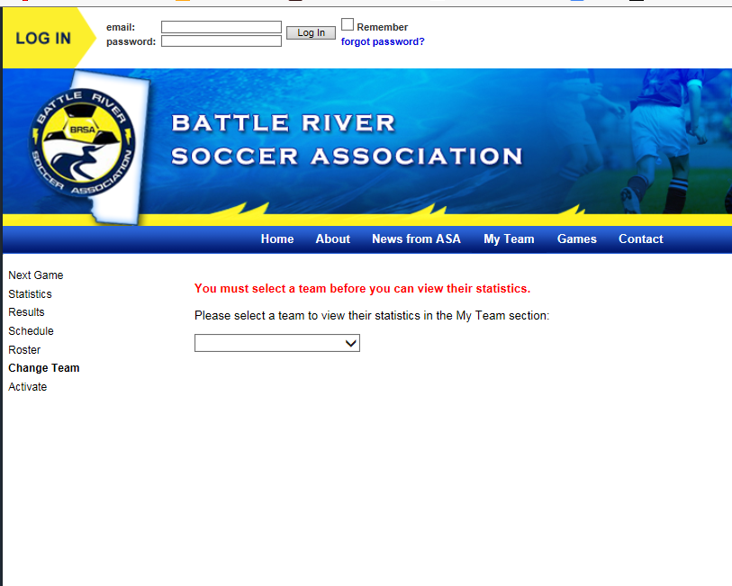
Activating your Team Account
Click on the My Team header
Click on the Activate link
You will be asked to enter an activation code. This code was given to your club via email.
Click next

Slide 5
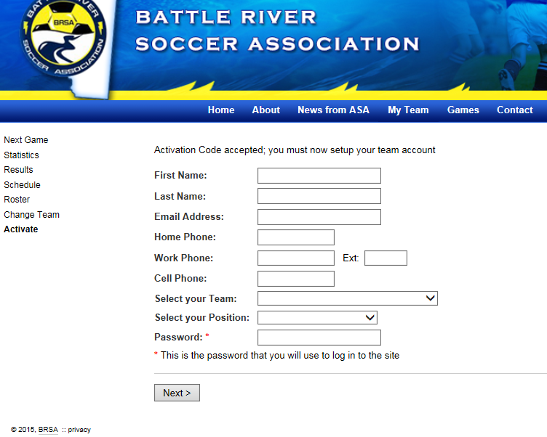
Entering Your Details
Next you will be asked for your details
Please ensure that you select the correct team. Other teams may have similar names
Finally you will be asked for your password. This is what you will use to log into the site in the future
Click next

Slide 6
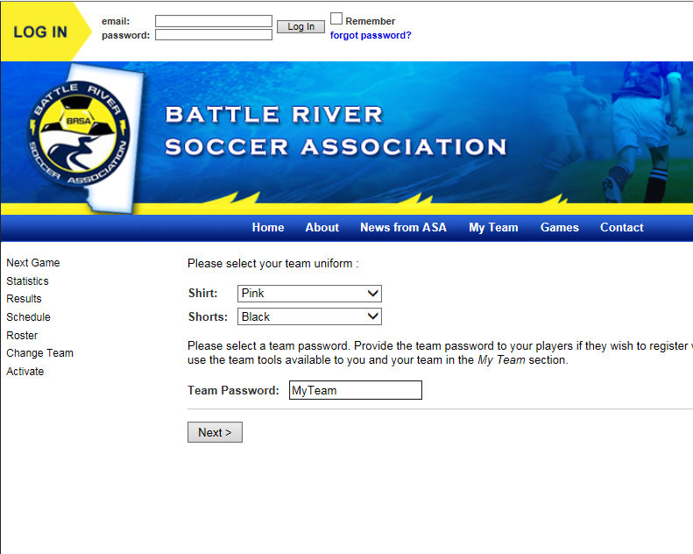
Uniform Colors
Next you are asked to select your uniform colors
Only the first person to activate your team account will see this step
When you have finished the activation you will notice more tools and options

Slide 7
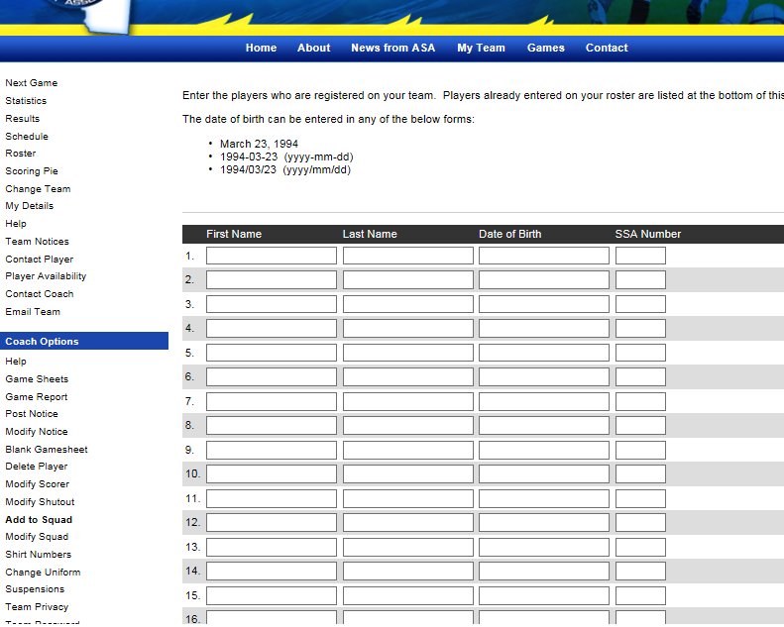
Entering the Team Roster
You will need to enter your roster into the database
To do this click on Add to Squad
Click on Submit to save
Use the Modify Squad tool to make any changes

Slide 8
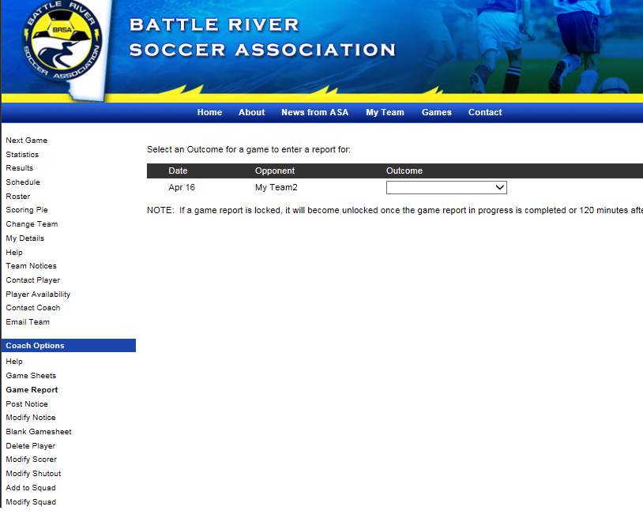
Submitting a Game Report
To submit a game report click on the My Team header and select Game Report
Follow instruction to completion

Slide 9
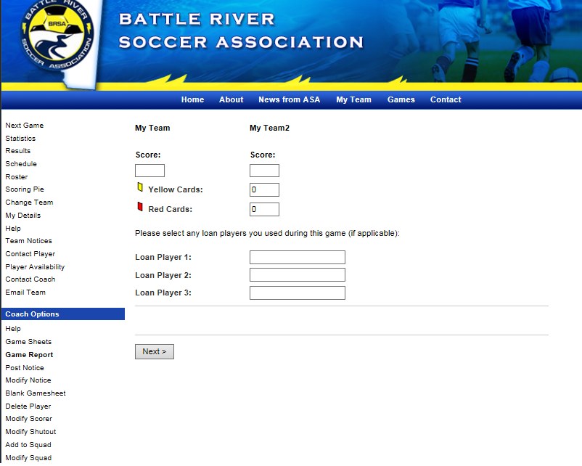
Entering Game Results
If you are the first team to submit a game report you will be asked to enter the results
If you are the second team to submit you will be asked to agree with the game score
Also enter the number of red and yellow cards your team had and any call ups or trialist players

Slide 10
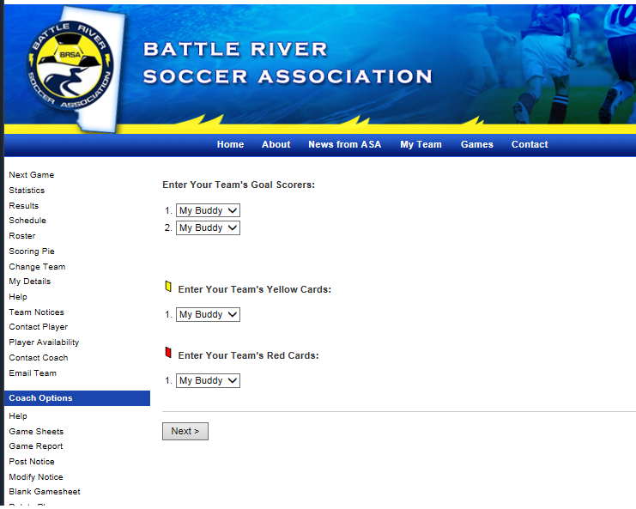
Entering Goals
Use the drop down boxes to enter names of goal scorers, the players who received a card and the goalie if there was a shut out
When both teams have submitted a game report the standings are updated and the results posted

Slide 11
Questions
Any questions can be directed to your club
or the BRSA Administrator
Sara Letourneau
admin@battleriversoccer.com
780-717-1962

